Slide 1

Database Project
Team member : Heewon Kim, Seonggi Kim, Seongbin Hong
Team3

Slide 2
Contents
1
Individual Role
2
Project Description
3
Demo Video
4
Lesson
Team3

Slide 3



2. Project Description
1 Individual Role
Everyone worked together but
Heewon Kim
Good At
Technical
Deployment
Seonggi Hong
Good At
Database
Desigin
Seongbin Hong
Good At
Organize
&
Create
Report
Team3

Slide 4
2. Project Description
2. 1 What our project can do
1) Implement all the features of phase 3
2) Concurrency Control
3) Recommendation Service
4) Searchable Under Complex Conditions
Team3

Slide 5
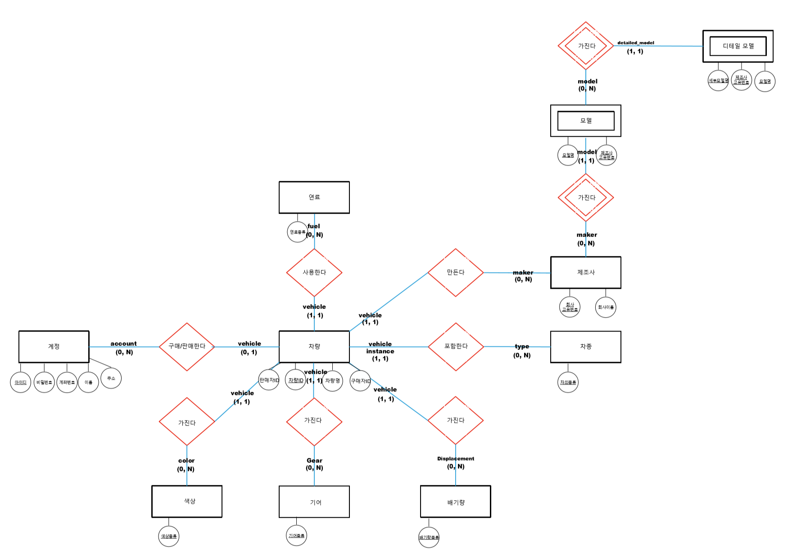
2. Project Description
2. 2 E-R Diagram
Team3

Slide 6
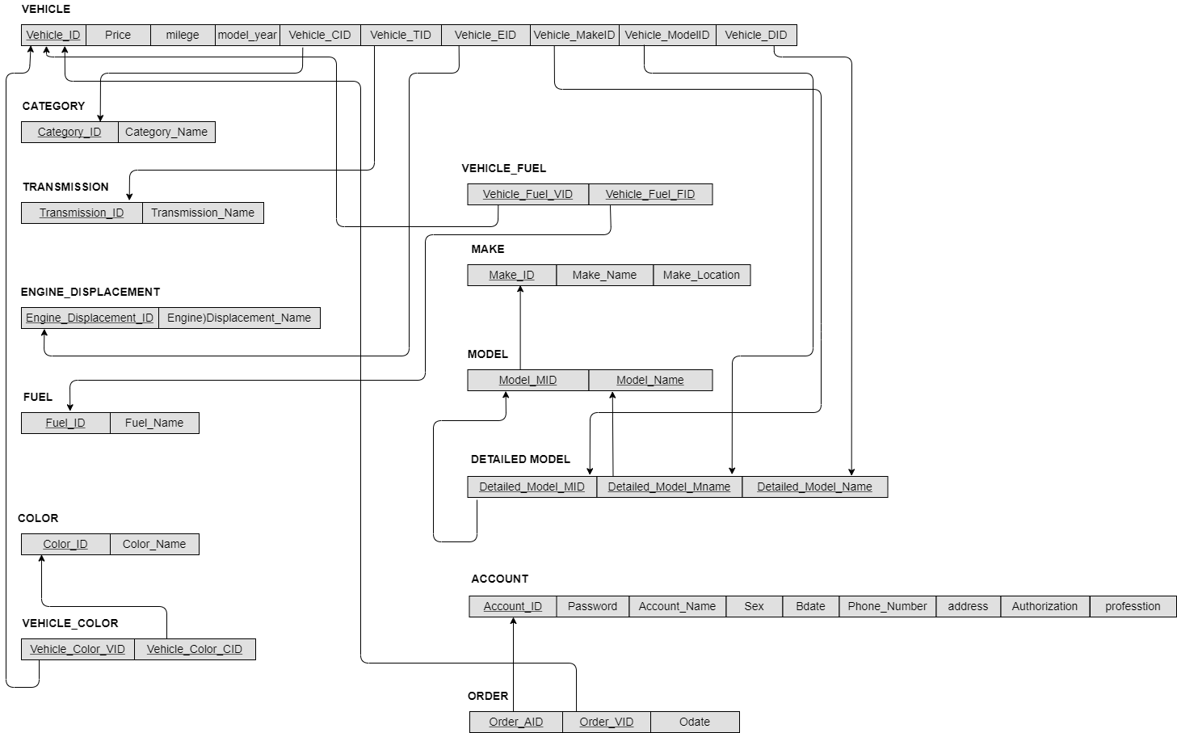
2. Project Description
2. 3 Relation Schema
Team3

Slide 7
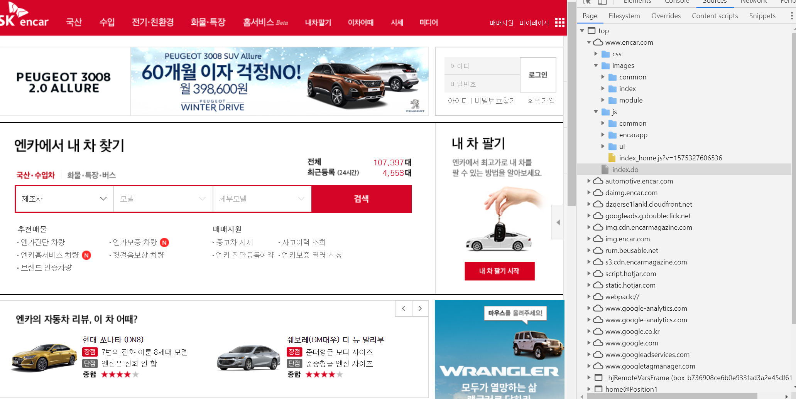


2. Project Description
2. 4 How to get data
Parsing With Python
Our data is actually on sale!
We have a lot of data from old cars to the latest ones!
Team3

Slide 8
2. Project Description
2. 5 Functionalities
1) Member-Related Function
Register
Change Member Info
Change Password
Login
Member Withdrawal
Logout
Team3

Slide 9
2. Project Description
2. 5 Functionalities
2) Vehicle-Related Function
Search For All Vehicles For Sales
Search By Manufacturer
Search For a Vehicle Under Certain Conditions
Search By Vehicle Name
Recommendation Service
Team3

Slide 10


2. Project Description
* Concurrency Control
1st
Team3

Slide 11
2. Project Description
2. 5 Functionalities
3) Transaction-Related Function
Check Your Transaction Details
Check All Vehicle Transaction (For Manager)
Check Sales By Month, Year, And Manufacturer (For Manager)
Team3

Slide 12
2. Project Description
2. 5 Functionalities
4) Manager-Related Function
Register For New Vehicle Sale
Revise Registered Vehicle Information
Revise Registered Vehicle Disclosure / Closure
Team3

Slide 13
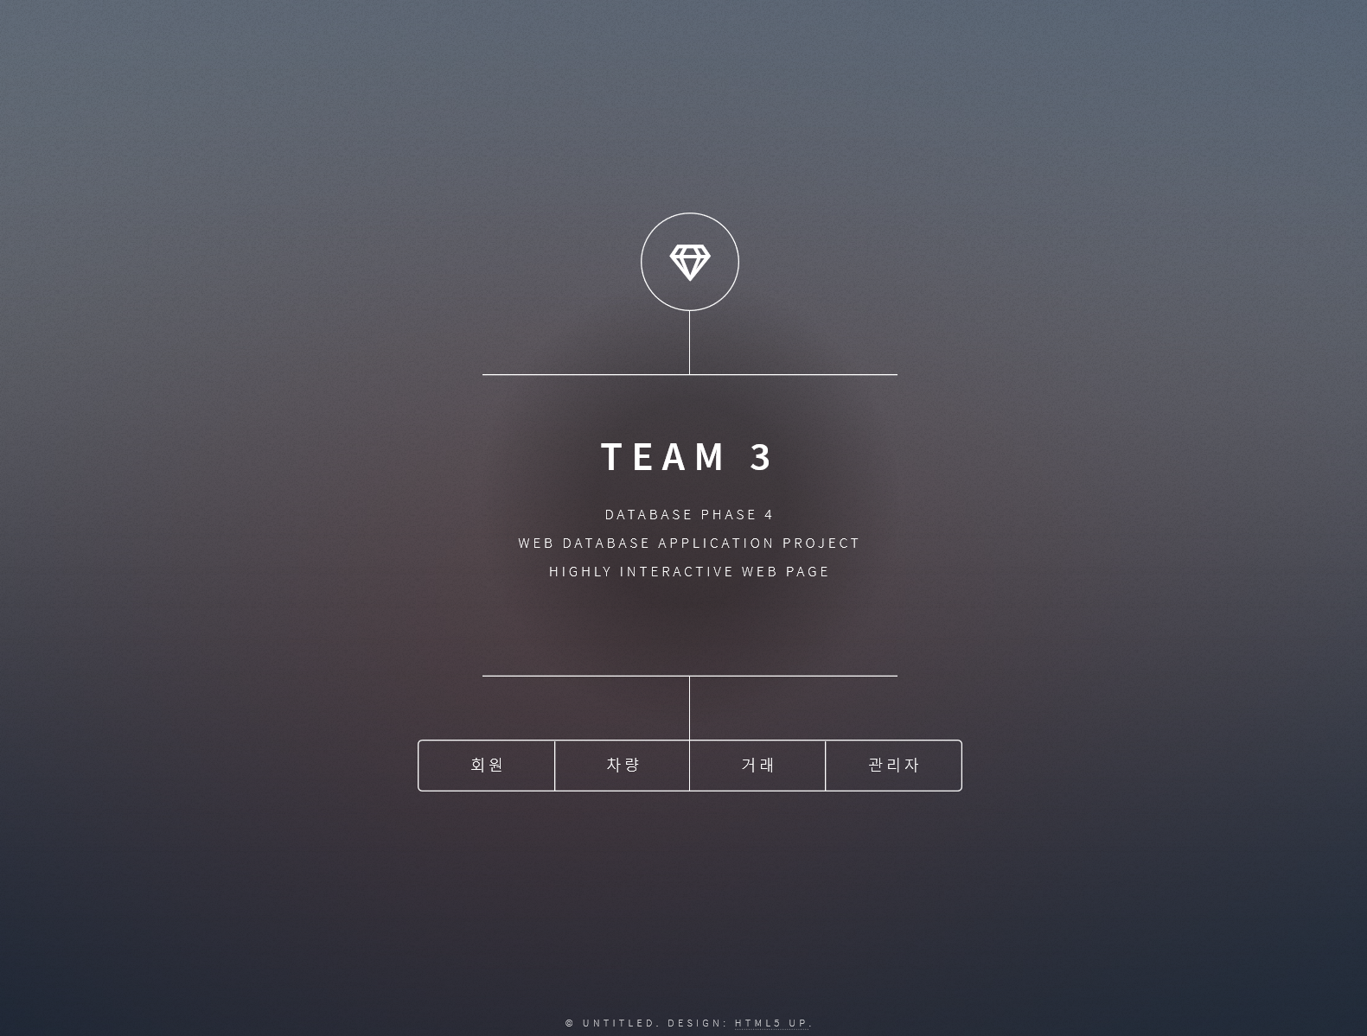
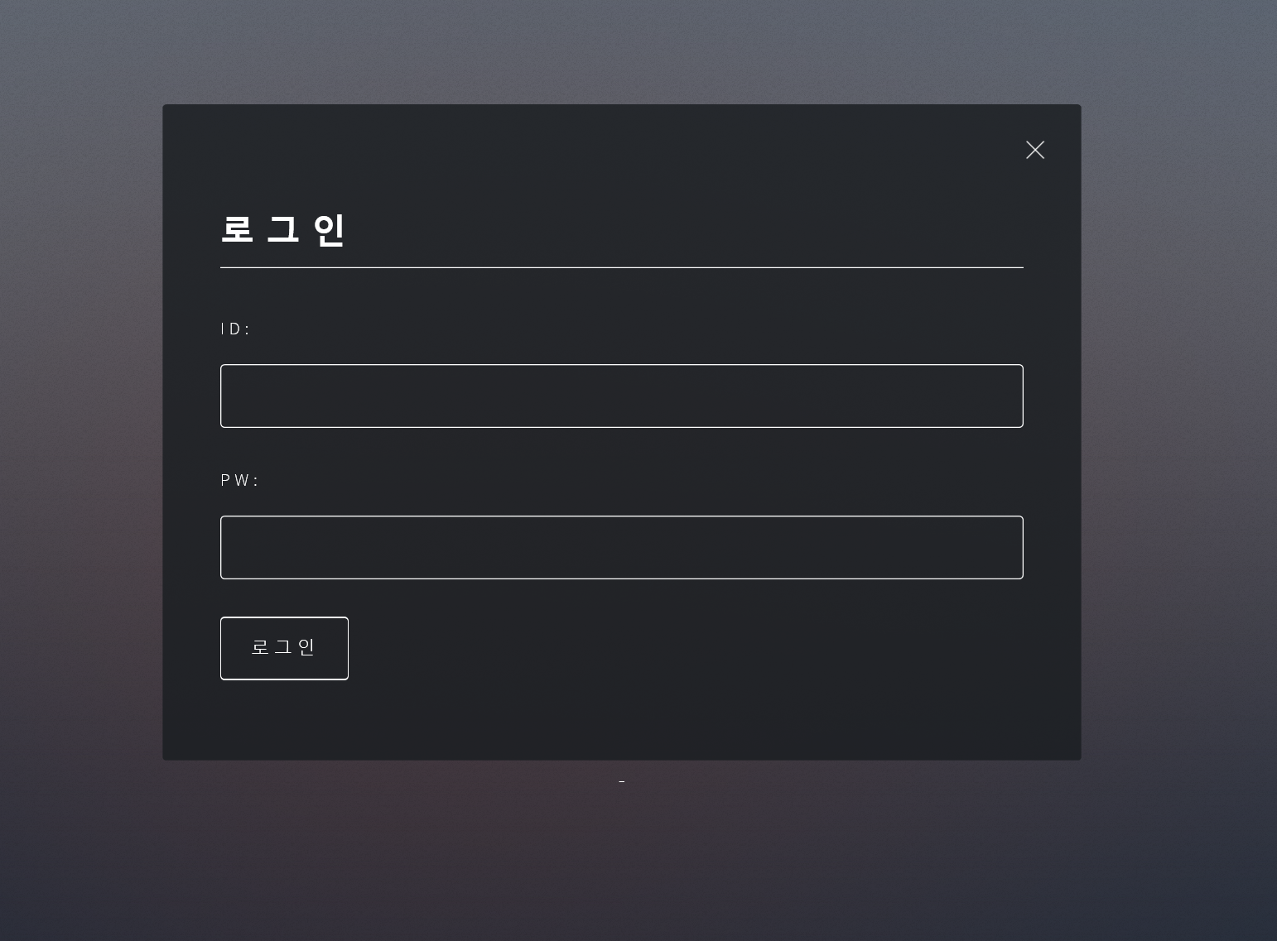
2. Project Description
2. 3 UI Design
Main Page
Login Page
Simple And Luxurious Desgin
Team3

Slide 14


2. Project Description
2. 5 Recommendation Service
: recommend according to gender, the same age
ORDER TABLE
Get user’s age and gender information
With select query
The most purchased vehicle for each condition
Team3

Slide 15
2. Project Description
2. 6 Summary Of Project Code
Total line of code :
OS :
DBMS :
Language :
IDE :
Github URL :
Team3

Slide 16

3. Project Description
3. Demo Video
Team3

Slide 17



4. Project Description
4. Lessons
We can get used to database!
From design to development,
We could experience many things!
We were impressed by the
well-crafted database technology!
This class is a really good lecture!
Thank you!!
Team3

Slide 18
Q&A
Principles & Methods to go Beyond UX
ANDRES OSPINA

Slide 19
YOUR TITLE
“Click here to add your text…
ANDRES OSPINA

